Slide 1
Passive Solar Heating
Passive heating is the spontaneous warming effect resulting from the absorption of solar radiation wherein solar energy is exploited to induce heat flow from the affected surface to indoor air, as well as promote heat storage within the building structure.
In the climatic zones requiring indoor space heating, it may be explored to use the following strategies:

Slide 2
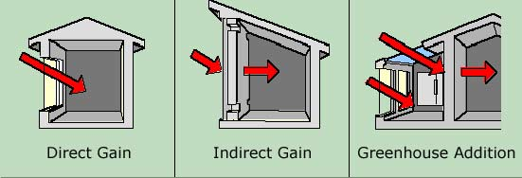
a) Direct gain method:
Controlled sun may be permitted into the habitable spaces through an opening to directly heat the floor, walls or other internal components and objects, which, in turn, heat the air within the room.
  Some examples of building materials that enable direct solar gain by acting as thermal storage mass are concrete, bricks, stone and water.
  The high thermal mass is usually located in the internal or external walls, floors or other built- in structures that receive sun directly.

Slide 3
b) Indirect gain:
A thermal storage wall may be placed between the glazing and habitable space which prevents solar radiation from directly entering the living space.
The solar energy incident on wall is absorbed by the wall and then indirectly transmitted to the habitable space over a longer time.

Slide 4
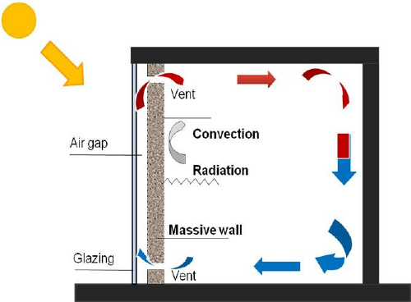
c) Trombe wall:
It is a thick solid wall with vents at its lower and upper ends.
This wall may be placed directly behind the glazing with an air gap in between.
The vents act as inlets of warm air into the room and as outlets for flushing out cool air from the room.

Slide 5
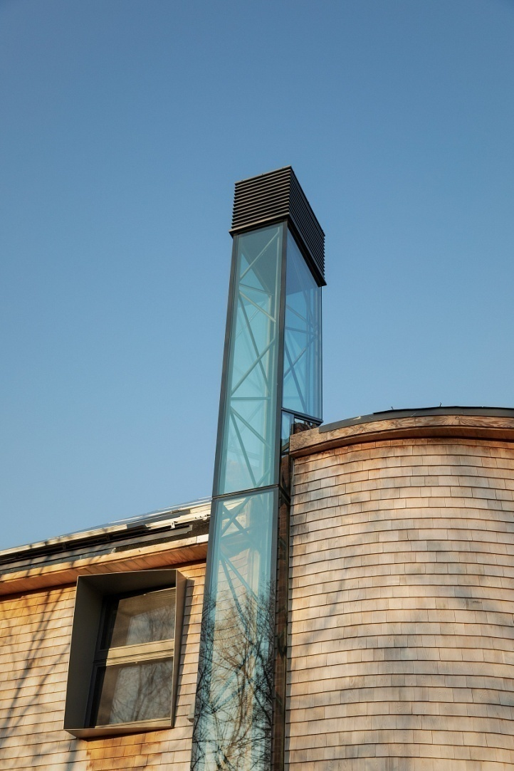
d) Solar chimneys .
This system is a kind of modified trombe wall that is incorporated into the roof.
A solar chimney is essentially a collector panel with minimum thermal inertia on the south facade of the building.
It absorbs incident solar radiation and heats up the air inside the space.

Slide 6
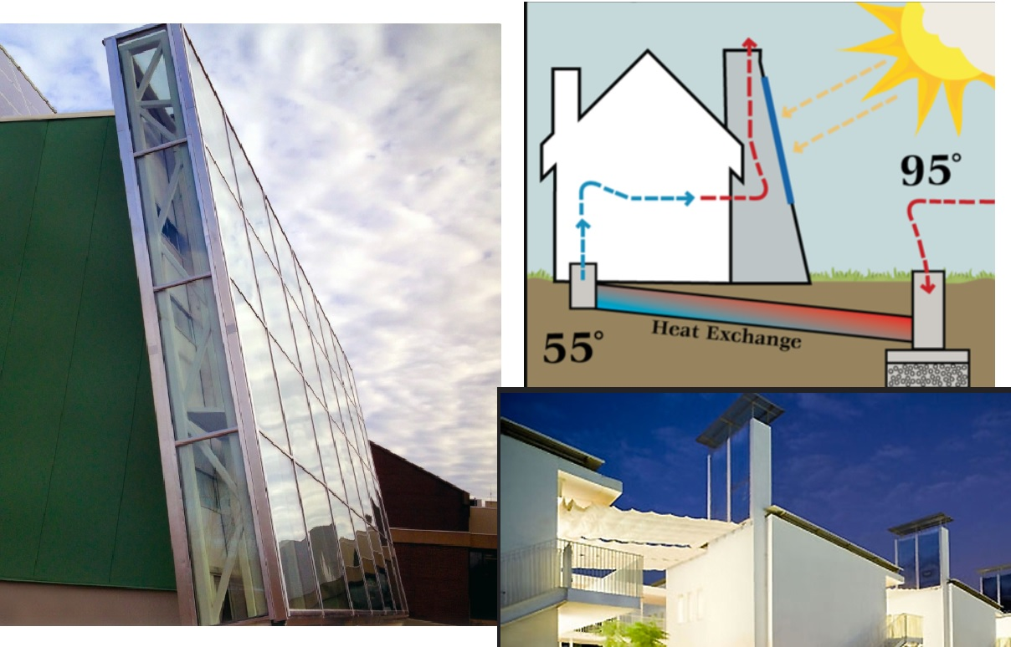

Slide 7
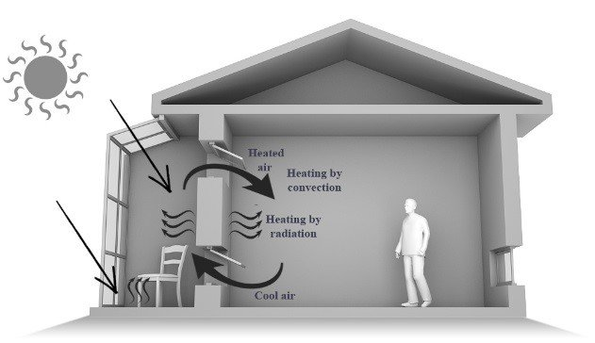
e) Sunspaces/Solaria .
It is an integration of direct gain and thermal storage concepts.
Solar radiation admitted into the sunspace heats up the air, which by convection and conduction through the mass wall reaches the habitable space.
It essentially consists of a greenhouse constructed on the south side of the building with a thick mass wall linking the two.

Slide 8
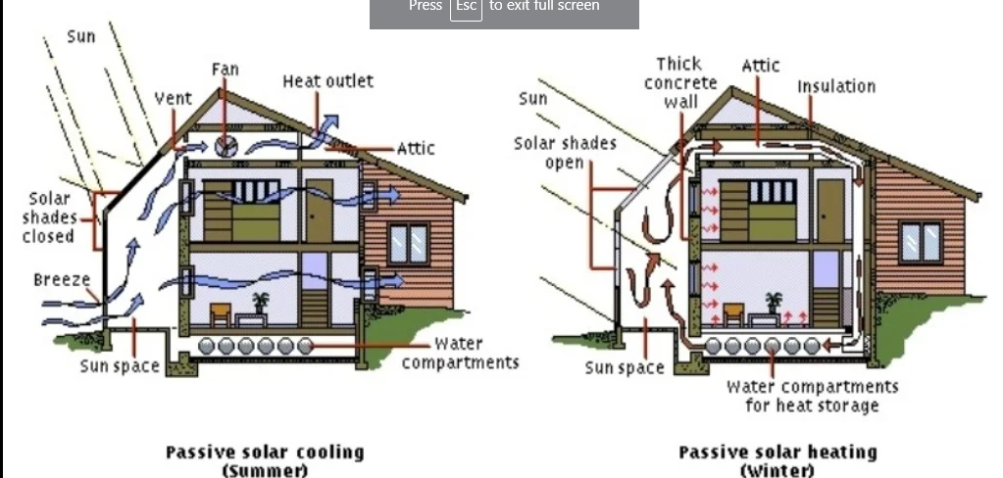

Slide 9
Passive cooling
Passive cooling systems are least expensive means of cooling a home which maximizes the efficiency of the building envelope without any use of mechanical devices.’
It rely on natural heat-sinks to remove heat from the building.
They derive cooling directly from evaporation, convection, and radiation without using any intermediate electrical devices,
All passive cooling strategies rely on daily changes in temperature and relative humidity.
The applicability of each system depends on the climatic conditions.
These design strategies reduce heat gains to internal spaces

Slide 10
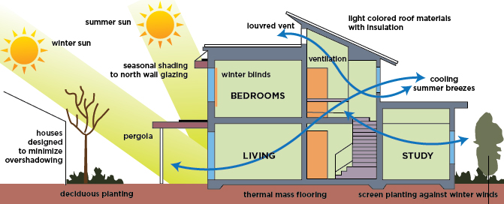

Slide 11
Passive Cooling
Ventilation
Wing wall
Thermal chimney
Earth Bearming
Earth air tunnel
Evaporative cooling
Roof pond system
courtyard

Slide 12
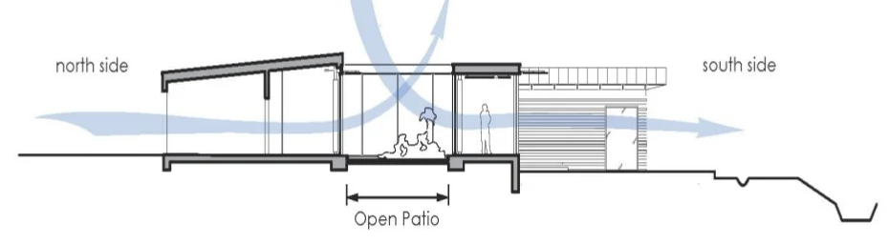
Natural Ventilation
Natural ventilation is the process of supplying and removing air through a space by natural means
It can be achieved with openable windows or trickle vents

Slide 13
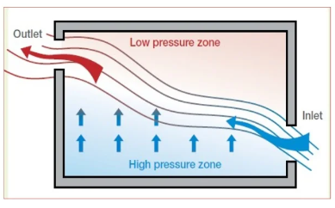
Natural ventilation and air movement can be simply achieved by structural controls as it does not depends on any form of external energy supply or mechanical installation
Outdoor breezes create air movement trough the house interior by the push-pull effect of positive air pressure on the windward side and negative pressure on the leeward side

Slide 14
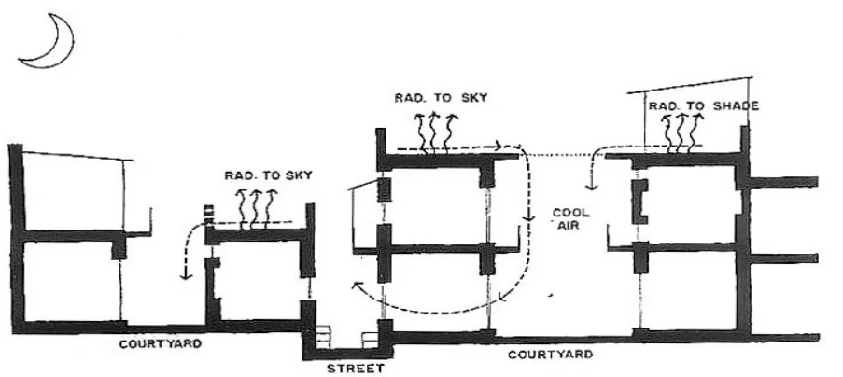
Natural ventilation started from history according to the different climates
The windows, play a dominant role in inducing indoor ventilation due to wind forces.
Typical section through shahajahanabad house, To facilitate the movement of cool air into the house, parapets are not build towards the courtyard

Slide 15
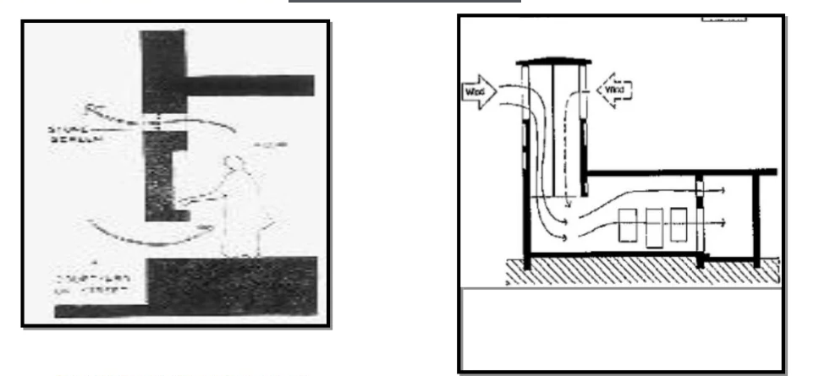
Double Apertures used for ensuring ventilation in Shahjaanabad house
Multi- Directional wind catcher

Slide 16
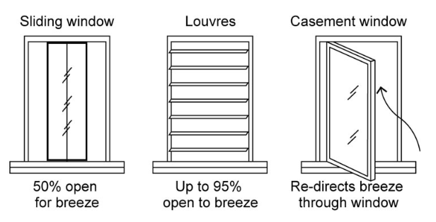

Slide 17
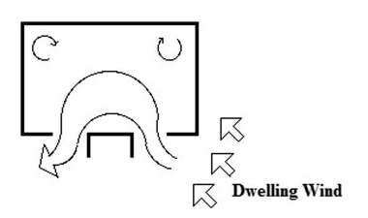
Wing wall
Wing wall is vertical solid panels installed alongside windows transverse to the wall on the windward side
It increases the speed of the natural wind and subsequently improves the cooling effect inside the house.

Slide 18
Thermal Chimney
The provision of a thermal chimney is another way to improve the cooling effect in a building.
It draws air out of the structure using convective currents.
Air can be drawn inside the building by generating a hot or warm zone with an exterior exhaust, hence ventilating the structure.
Adequate detail of the thermal chimney is shown in Figure

Slide 19
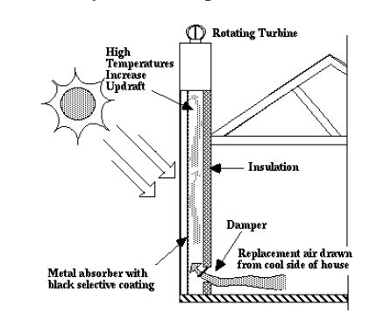
Thermal chimney

Slide 20
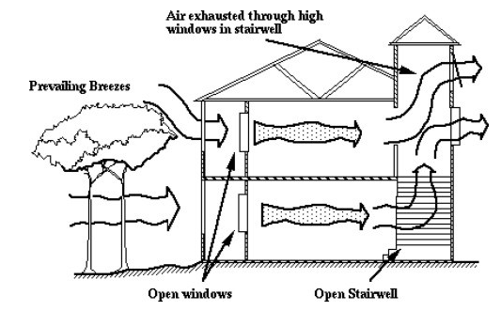
Thermal chimney effect build into home

